Slide 1




INDUSTRY TALK
DUBBING-SUBTITLING-ASSETS MANAGEMENT-RESTORATION
WITH
POLAND Ι VIETNAM Ι SINGAPORE Ι KENYA Ι NIGERIA

Slide 2


HIVENTY SHORT BRIEF OVERVIEW

Slide 3
HIVENTY IN A FEW FIGURES
Trusted partner to the Entertainment industry on content creation, distribution and preservation
Over 35 years of expertise in technical services to the entertainment industry
46M$ turnover in 2020
380 full time employees worldwide
4 core businesses and fields of expertise : post production services, asset management and deliveries, localization, preservation and restoration
Founding member of EGA / Member of DPP
Official partner of Cannes Film Festival
Netflix preferred vendor: NPFP, NP3, DTT, Globalization
TPN certification

Slide 4
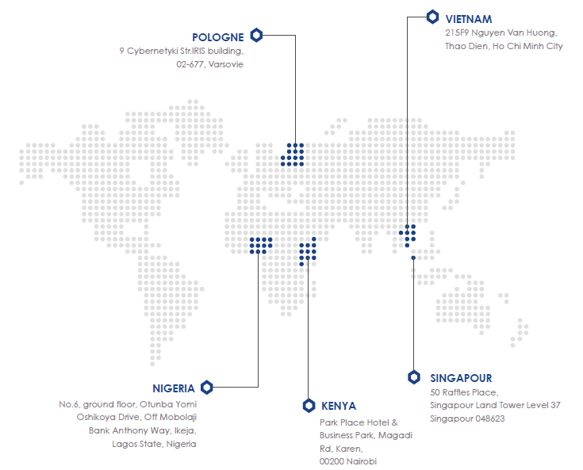
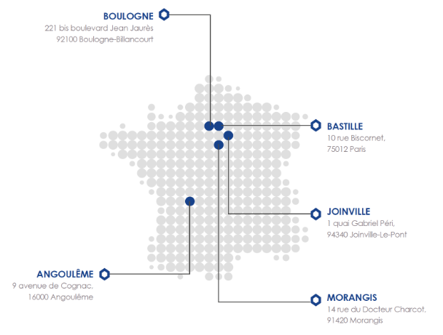
HIVENTY - WORLDWIDE PRESENCE

Slide 5
HIVENTY - AMBITION
AMBITION OF THE GROUP
Trusted partner to the entertainment industry on our 4 core businesses:
Trusted partner to achieve content partner’s creations (Post-production)
Trusted partner to deliver contents on all media (Content Distribution)
Trusted partner to deliver contents to all audiences worldwide (Localization)
Trusted partner to preserve contents over the time (Classics)
=> Help Content owners to create and sell their programs worldwide
=> You produce and sell, we care about all the rest

Slide 6








HIVENTY - RECOGNITION
SECURITY
CSR
APPROVED BY

Slide 7
HIVENTY - VALUES
OUR VALUES :
Sharing the world stories (founding Member of EGA): Our involvement to be present in all continents and to contribute promoting films and series from everywhere and all cultural backgrounds
CSR policies: Our involvement in preserving earth and its leaving resources trying to reduce our footprint
Inclusion: Our involvement in respecting everyone’s essence whatever the color, religion, sex...
Respect of creations: Our involvement in respecting the creative intents of storytellers and make sure they are preserved until final deliveries.
Find solutions to make business: develop workflows and tools fitting content owners’ needs

Slide 8
ENTERTAINMENT & MEDIA
GLOBAL MARKET OVERVIEW

Slide 9
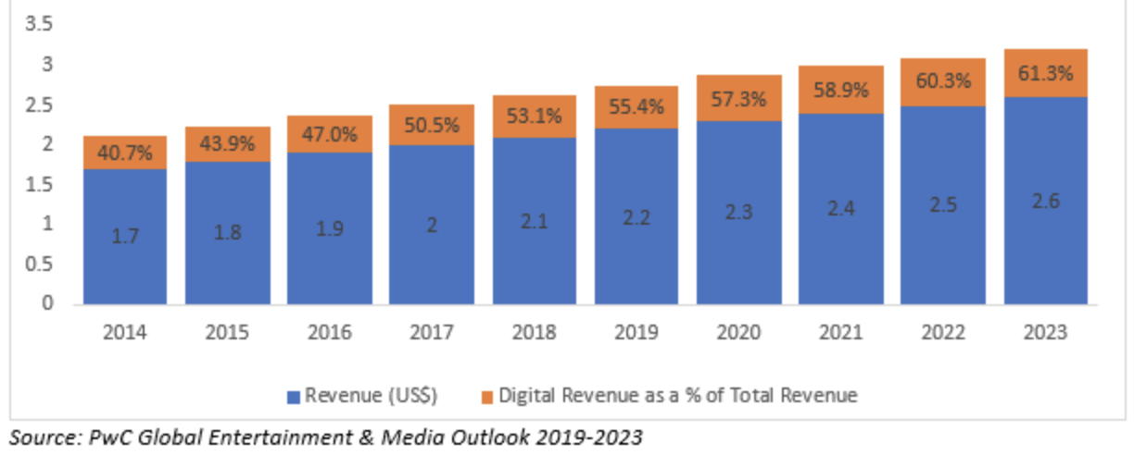
DIGITAL REVENUE VS GLOBAL E&M REVENUE
Trillion$
=> Global revenue Media & Entertainment: 2.3 bn$ in 2020, forecast growth 2.6bn$ in 2023
=> USA represents approx. 39% of the global market in 2019. However China should overtake the American market by 2023
=> The digital revenue represented 57.3% of the 2.3tr$ entire global Entertainment & Media revenue in 2020 and will reach 61% of the 2.6tr$ global revenue in 2023.

Slide 10
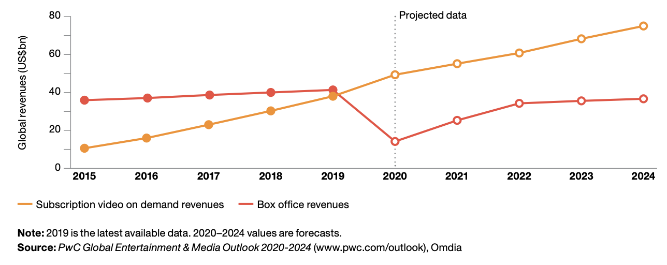
SVOD VS BOX OFFICE
=> In 2020, the subscription video on demand revenue is now higher than the box office revenue and will double by 2024

Slide 11
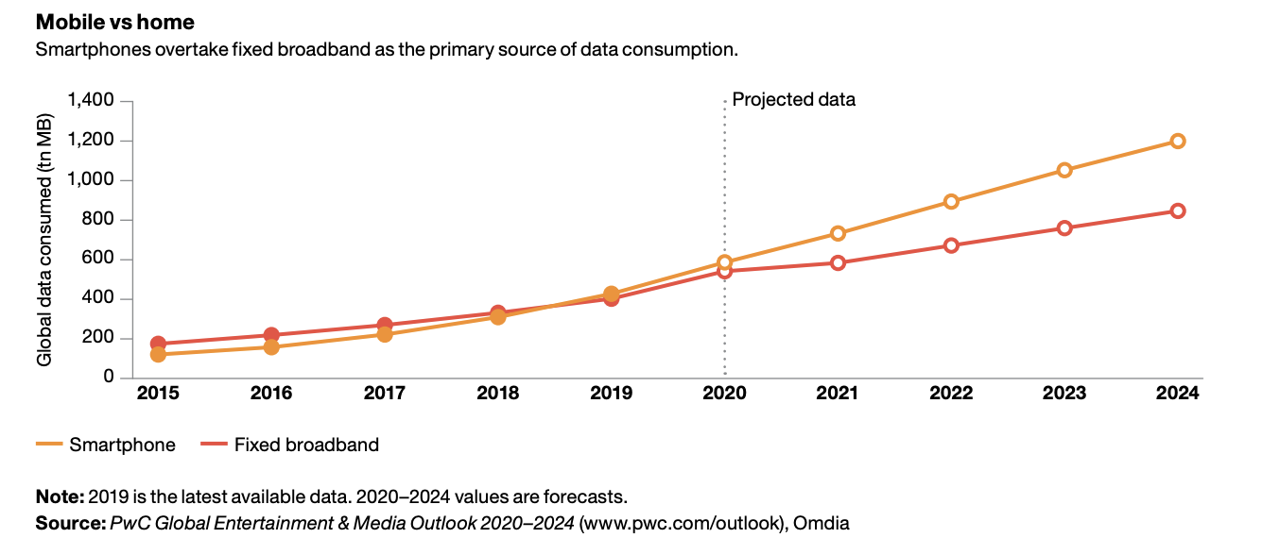
MOBILE VS FIXED BROADBAND
=> In 2020, smartphones overtake fixed broadband as the primary source of data consumption. 49% of the worldwide population is connected to mobile Internet and should reach 61% by 2025, for which the higher growths are expected to be in Sub Saharan Africa and in Asia Pacific.

Slide 12
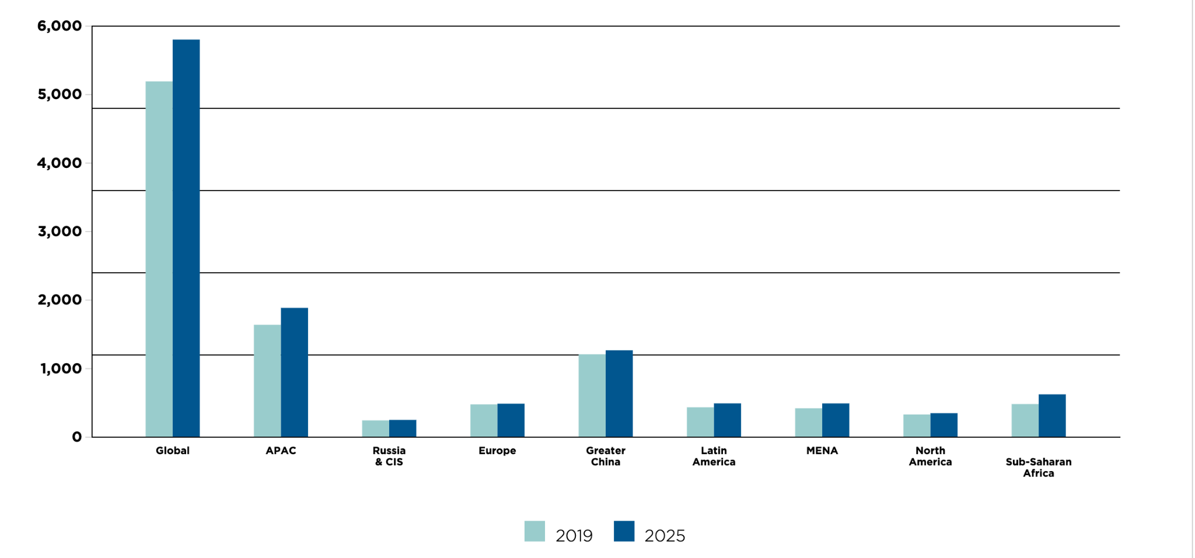
UNIQUE MOBILE SUBSCRIBERS
=> 52% of the global population is connected to 4G and it should reach 56% in 2025. While 20% will be connected to the 5G by 2025. Main market growth are expected to be in Asia and Africa.

Slide 13
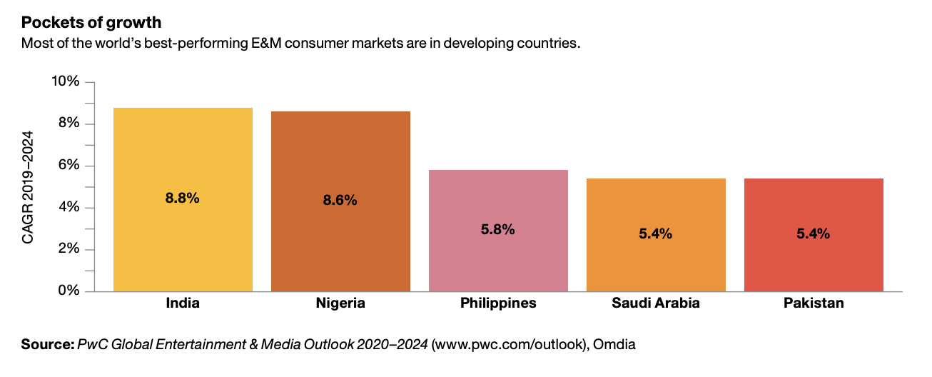
RAPIDE VUE MARCHE AV GLOBAL
=> Most of the world’s best-performing E&M consumer markets are in developing countries over a forecast period 2019-2024, leading by India & Nigeria

Slide 14
AFRICAN MARKET VS ASIA
OVERVIEW

Slide 15
AFRICAN MARKET VS ASIA
AFRICA: Population:1.1Bn, the quickest worldwide demographic growth: 2.7% per year, +58% in 20 years (+19% worldwide), middle class tripled in 30 years, representing 34% of the Sub-Saharan population, average age of the population: 20/22 years.
ASIA: 55% of the worldwide population. Aging population. 35% of the worldwide GDP. 50% of the worldwide middle class (est. 66% in 2030)
Mobile - Africa:
26% of the Sub-Saharan population connected to Internet via the mobile including 9% connected to 4G.
Est. 2025: 39% connected to Internet via the mobile including 27% in 4G.
75% of the Sub-Saharan territories covered by 3G / 49% covered in 4G in 2020
130M of new mobile subscribers by 2025
=> Fast change in content consumption: from public broadcasters to a diverse streaming offers on mobile or smart TV.
Mobile - Asia:
48% of the APAC population connected to Internet via the mobile (approx 2bn) including 61% connected to 4G.
Est. 2025: 61% connected to Internet via the mobile, including 23% in 5G.
250M of new mobile subscribers by 2025

Slide 16
AFRICAN MARKET VS ASIA
Focus Nigeria:
1st TV & Film producer in Africa
3rd worldwide producer in terms of revenue: 4Bn$ per year (17 for India /589 for the USA!). Estimation to double in 5 years.
2nd worldwide producer right after Bollywood in terms of number of content produced (2,500 features/year).
Low-cost market, however, fast changing.
Pay-TV:
For the moment, the market is still dominated by Pay-TV: 22.6M subscribers
Est. 2025: 50M subscribers including 11M in Nigeria and 9M in South Africa
Multichoice/DSTV: 14M panafrican subscribers d’abonnés - leading the Anglo-Saxon market
Canal+ is leading the Francophone Pay-TV market with 6M subscribers (+20% in comparison with 2019) including 5 bouquets, 216 TV & Radio channels + FTA offer in Ivory Coast, its new bouquet launched in 2021 in Ethiopia as well as its Nollywood offer. Canal+ generated a revenue of 6.5M$ in 2020 in Sub-Saharan Africa.

Slide 17
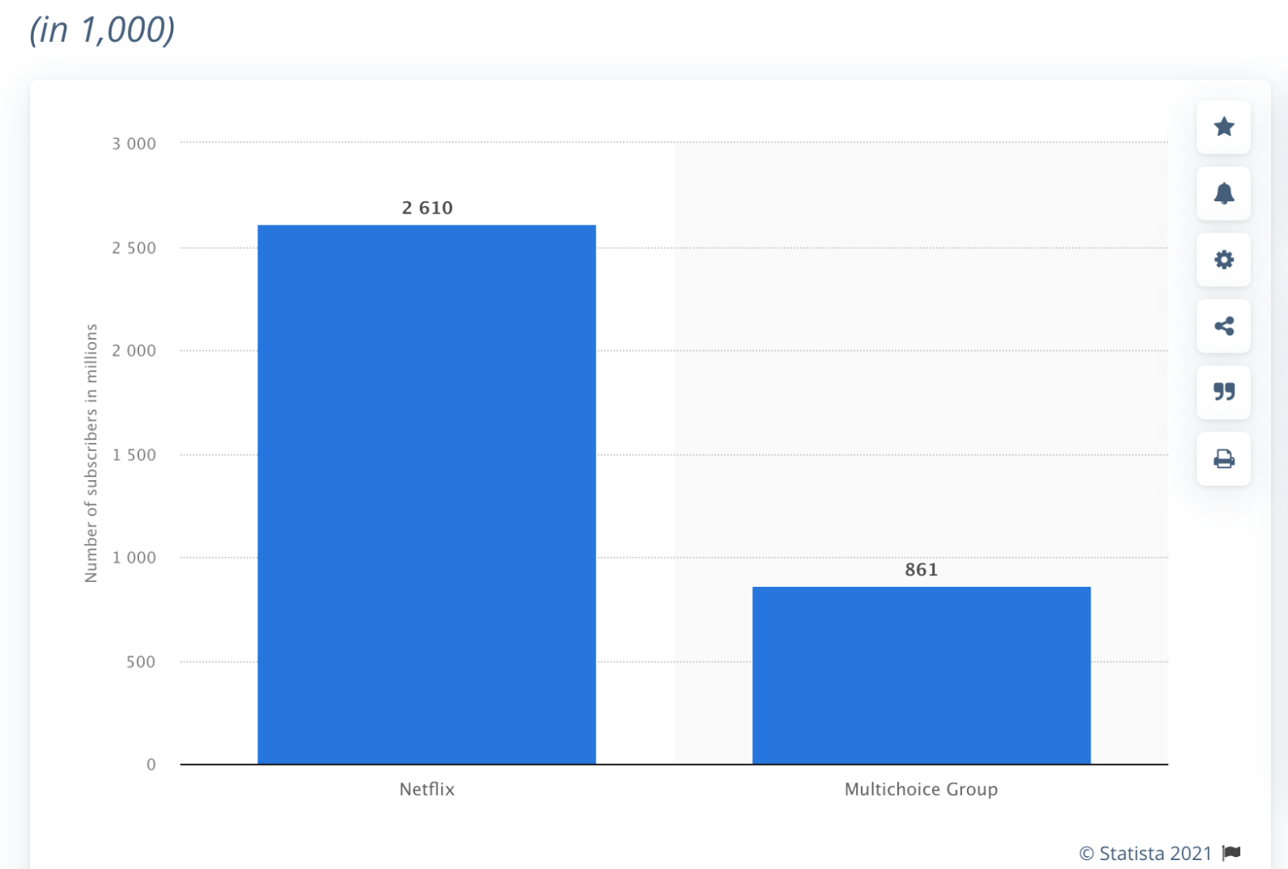
AFRICAN MARKET VS ASIA
OTT - Africa:
Swift OTT spread. Netflix or Amazon Prime entered in 2016 and Netflix is accelerating its African acquisitions and original productions since 2019.
Netflix owns 57% of the SVOD market with approx. 2.6M subscribers in 2021. Est. 2026: 6.2M, equivalent to 44% of the market. Drop due to the arrival of Disney+ scheduled in 2022 and which should quickly gain 3M subscribers.
ShowMax counts 860K subscribers. However, it’s increasing with a more and more aggressive content offer.
By 2026, the Sub-Saharan region should count 13M OTT subscribers creating a revenue of 1.7 Bn$, equivalent to a +340% growth.
What is a stake for futures: SVOD to AVOD shift and payment solutions/options.
=> Massive business opportunities for the platforms thanks to the fast growing mobile Internet connectivity, the young population, the fast increasing of the middle class.
Number of subscribers Netflix/showmax in Africa in 2021

Slide 18
AFRICAN MARKET VS ASIA
OTT - Asia:
The OTT market is fast growing in Asia with 400M subscribers (Excl. China & India)
The 3 main streaming markets (Excl. China & India) are Singapore (91%), Indonesia (76%) and Australia (81%) through mobile Internet and mart TV.
Vietnam is booming having a smartphone’s penetration rate of 70%
Market is diverse with local, regional and international offers. The Asian consumers, on average, subscribe to 3 to 4 VOD offers.
Local platforms such as HOOQ-SING, VIU-HK or IQIYI-China) are mainly offering Asian content while the US Majors are offering worldwide content, including African content.
The AVOD offer is booming in Asia (51% of the subscribers), unlike Europe and USA subscribing to SVOD offers. Consequently, AVOD offers are now concentrating the ADs revenues, whic is a trend that should come in Africa.
In India, the main OTT platform is Hotstar (Star India) - 300M subscriber o its own! However, it exists more than 50 OTT players in all Indian regions offering local content localized in the 10 main Indian languages.
By 2024, the OTT markets will count for 30% (3Bn$) of the entire M&E Indian market.
The Majors are Hotstar-Disney+ (2019), Amazon (2016) and Netflix (2016), followed by Zee5 and SonyLiv.
Asian estimated OTT growth: 7.2% 2020-25.

Slide 19
EVOLUTION OF THE MARKET - RECAP
Since Netflix came into the global market, and more generally the OTT platforms, programs are now available everywhere and are airing simultaneously in multiple territories.
Globally wise, in 2020, the subscription video on demand revenue is now higher than the box office revenue and will double by 2024.
On the same basis, the digital revenue represented 57.3% of the 2.3tr$ entire global Entertainment & Media revenue in 2020 and will reach 61% of the 2.6tr$ global revenue in 2023.
In 2020, smartphones overtake fixed broadband as the primary source of data consumption.
49% of the worldwide population is connected to mobile Internet and should reach 61% by 2025, for which the higher growths are expected to be in Sub Saharan Africa and in Asia Pacific.
The tech is improving in terms of robustness and stability
The OTT platforms are expanding at 3 different levels: local, regional, international offering all kind of content, stimulating sales and creating a positive competitive market.
=> People can now access and consume any kind of content, whatever its origin or its genre and therefore, localizing content is becoming one of the key components to widely distribute and increase revenues. Meanwhile, content producers are facing new challenges to fulfill the international technical standards. In addition, many content owners are seated on thousand of hours of dormant valuable assets, which are not properly stored, qualified and visible to potential buyers, or are damaged and unusable and for which asset management tools and restoration could contribute to boost new business opportunities.

Slide 20
LOCALIZATION, DUBBING & SUBTITLING
BUSINESS OPPORTUNITIES

Slide 21
LOCALIZATION, WHY IT HELPS INCREASING PROFITS
According a McKinsey survey done in 2021, 75% of the non English native speakers consumers preferred to watch a content in their native languages.
Netflix were able to increase their revenue by nearly 50% by localizing their content.
Localization is a mechanism that helps to reach wider audiences of different dialects and languages through translation, dubbing, subtitling, voice-over or closed-captioning videos.
The success of the localization is to deliver the same content to an audience that speaks a different language without losing the essence and meaning of what was said originally.
According to WHO, 5% of the world population, which corresponds to 430M people, have issues with hearing. So, without closed-captioning and subtitling video content, there is no way for your content to reach those people. A study has shown that transcription and closed captioning videos can increase views by over 40%.
On top, Localization is a way to increase the value of your assets + recoup your investment by selling to several markets sharing the same language
=> The key to success lies in the successful implementation of language localization, which is the way to expand worldwide.

Slide 22

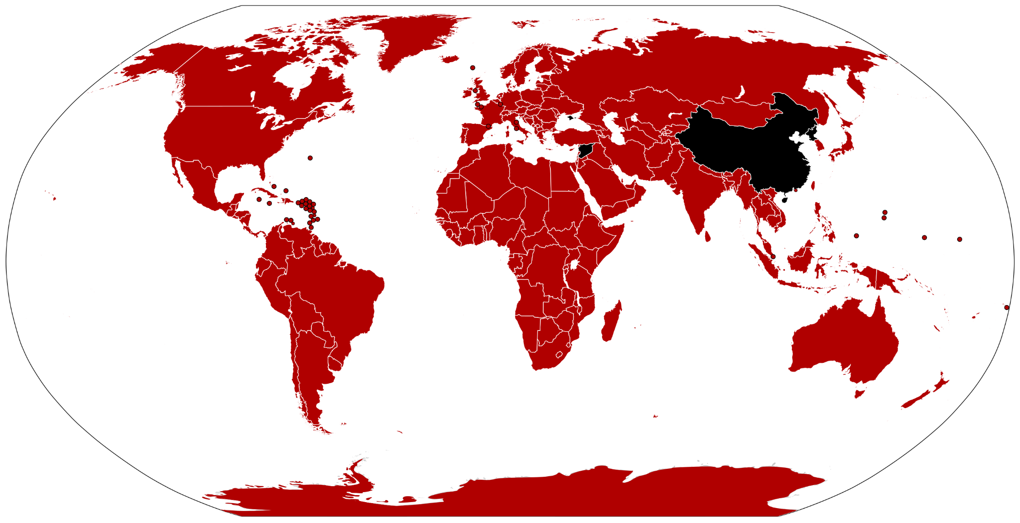
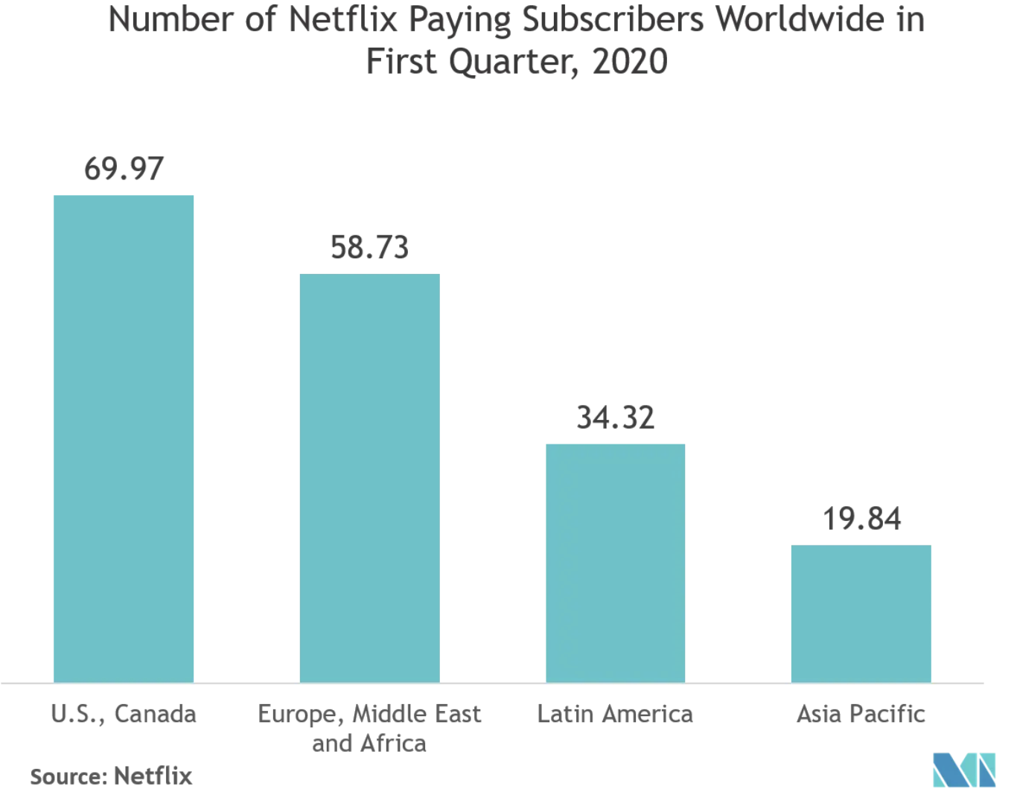

THE US MAJORS OTT PLATFORMS & THE LOCALIZATION

Slide 23

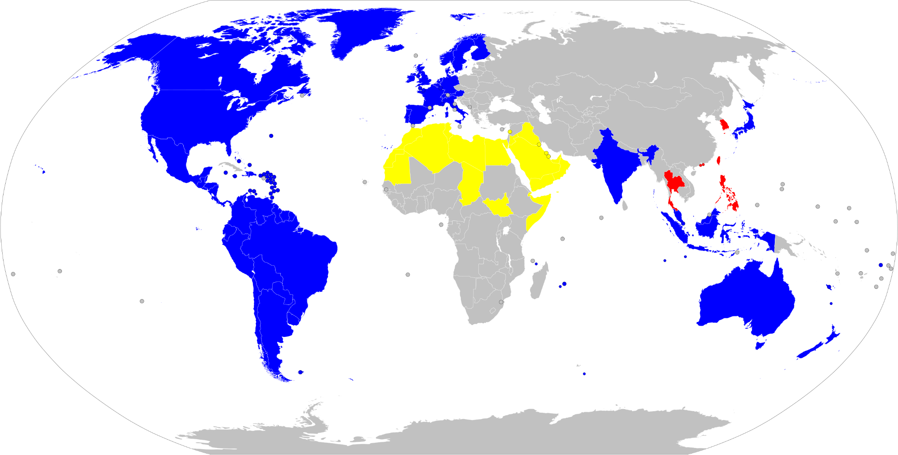
THE US MAJORS OTT PLATFORMS & THE LOCALIZATION

Slide 24
THE US MAJORS OTT PLATFORMS & THE LOCALIZATION
OTTs platforms such as Netflix (209M subscribers) or Amazon (200M subscribers) are available worldwide, however, they are yet to be localized in each territory
Localized content are fully deployed in North & South Americas and Europe (especially by Netflix & Amazon). Asia is ongoing with Netflix leading, Disney following and Amazon mainly focused on Japan.
Netflix is now expanding its localized content to Sub-Saharan Africa and is more and more aggressive into the African content acquisitions (licensed & branded) and original productions,
Disney+ is aiming to complete its roll-out in Asia by mid-2022 and to start its sub-Saharan Africa roll-out by 2022
HBO Max (44M subscribers) is following the trends and is now starting localizing in Europe, in the Indian sub-continent & in the APAC regions. So we could expect that once these deployments are completed, HBO Max will move to the Sub-Saharan region.
=> US Majors main trends: Consolidate their offers in US and Europe. Carry on their Asian roll-out. Expand in Africa.
=> The key languages for Africa: African French (120M speakers), African English (200M), Swahili (120M), Haussa (50M), Oromo (30M), Yoruba (30M), Amharic (30M) and Zulu (10M)
=> Dubbing preferred to Subtitling due to a illiteracy rate of 40%.
=> Subtitling: a huge educational role to play in addition to SDH for hearing impaired people.

Slide 25
LOCALIZATION, WORKFLOWS QUICK OVERVIEW
SUBTITLING
To be provided by the content owner/distributor/broadcaster
Proxy file or Video Master
Original dialogue list (or script/SRT file)
Work done by Hiventy:
Creation of a proxy file (in the event a Master only is provided)
Ingest of all source materials
Spotting
Translation from original version to target language
Full proofread
Spot QC
Delivery: Subtitle file in sync with image reference and/or Burnt-in subtitles embedded into the video
DUBBING
To be provided by the content owner/distributor/broadcaster
Proxy file or Video master
Original dialogue list
M&E
Optional: Printmaster and music cue sheet.
Work done by Hiventy:
Creation of a proxy file (in the event a Master only is provided)
M&E QC
Casting
Spotting / Detection
Translation / adaptation
Adaptation review or proofread
Recording
Artistic Direction
Editing
Mixing in 2.0 and/or 5.1
QC
Delivery: Full mix in .wav file in sync with image reference, Separate stems, Dubbing script, List of inserts, Song reports and/or KNP

Slide 26
FILM HISTORY
& RESTORATION OPPORTUNITIES

Slide 27
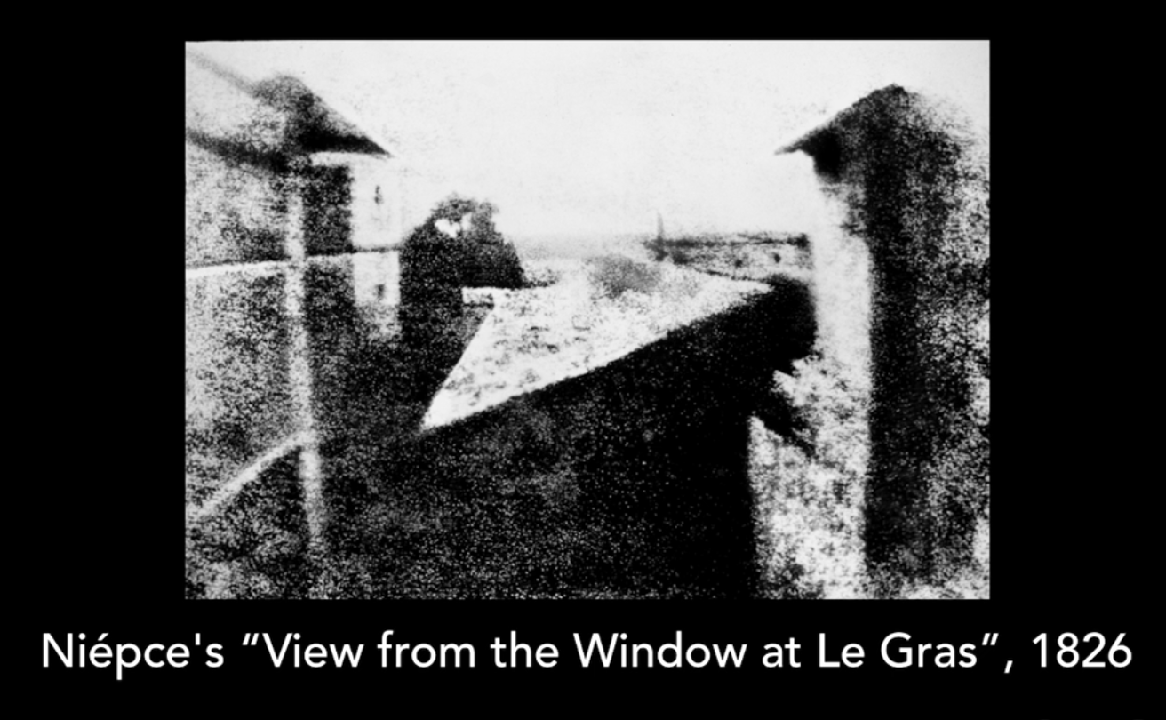
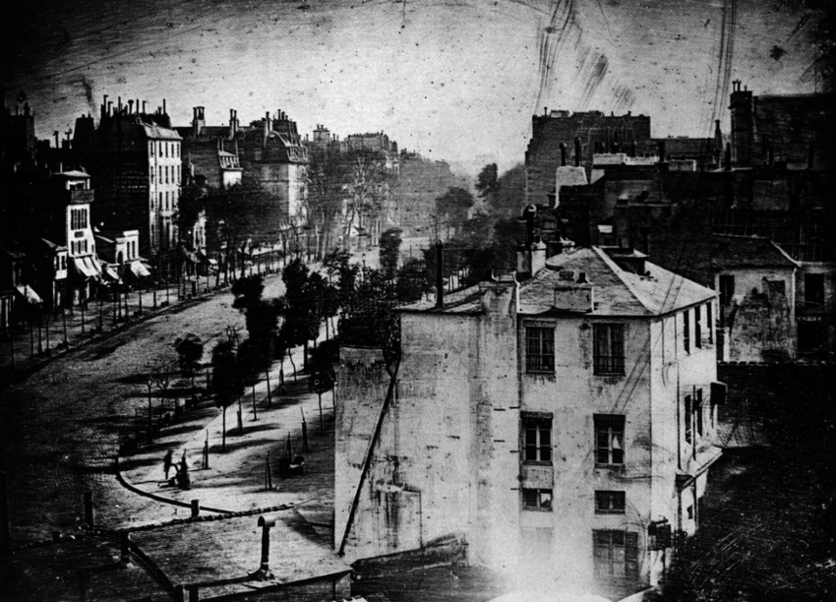
FILM, A BIT OF HISTORY
Joseph Nicéphore Niépce
This is the first black and white photograph.
It was taken in 1826 by a French Inventor named Joseph Niépce.
He referred to the product of his process as the heliograph or the sun drawing.
The image had an exposure time of 8 hrs.
Louis Daguerre
In 1837 Daguerre, invented the Dauerreotype process.
In comparison that to Niepce’s process, Daguerre’s process was much more efficient as it took several minutes process.
The Boulevard Du Temple – is actually the first photograph of a person and was taken in 1838.
In 1839 the Dauerreotype process was commercially introduced. (The year of birth for still photography).

Slide 28

FILM, A BIT OF HISTORY

Slide 29
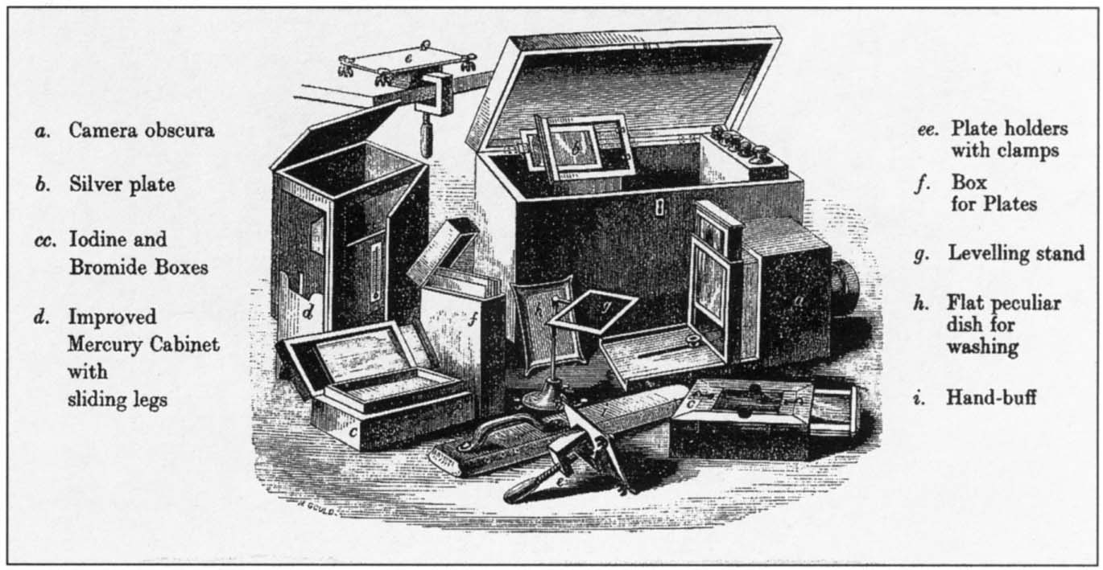
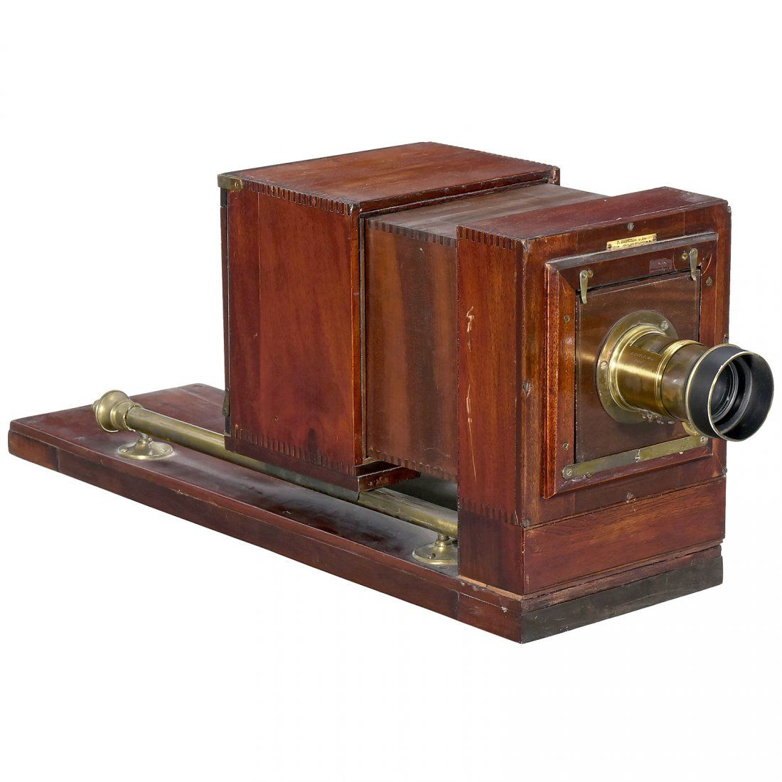
FILM, A BIT OF HISTORY

Slide 30
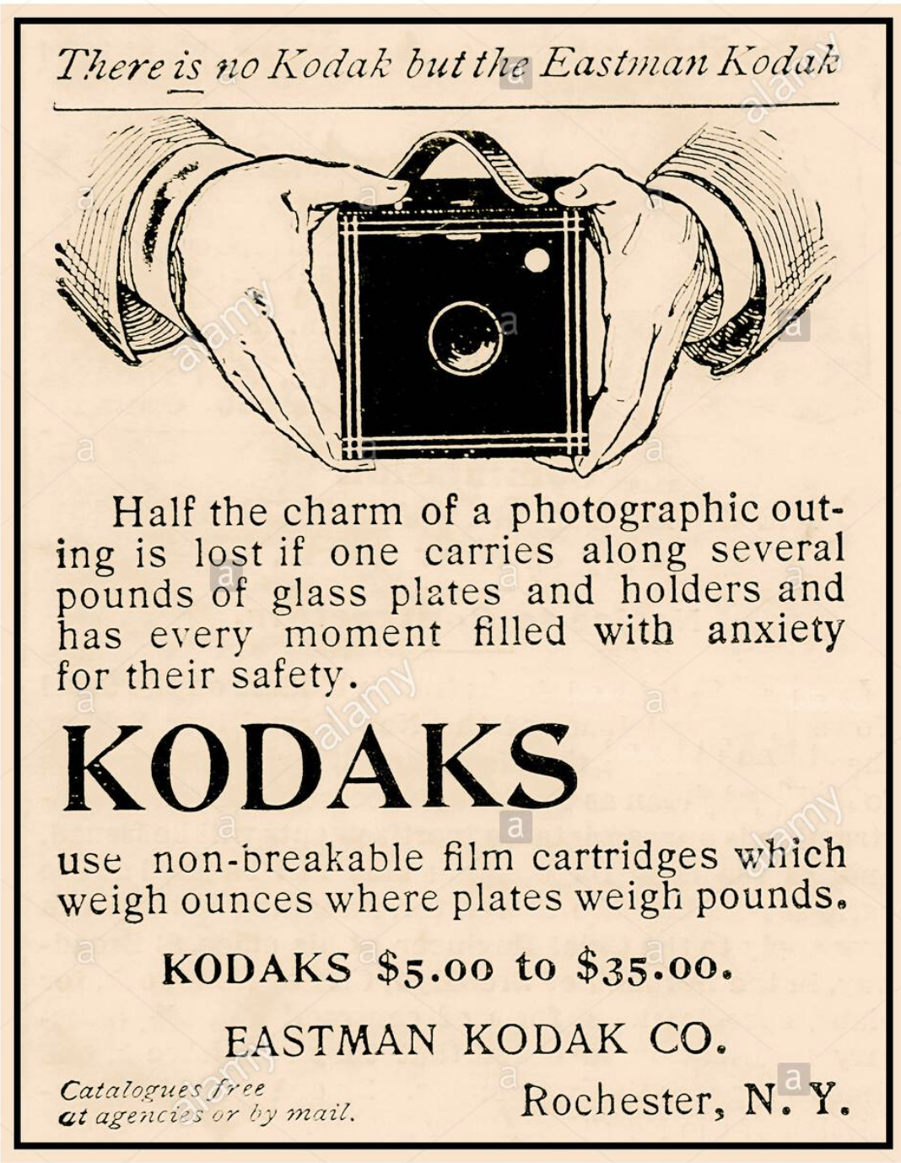
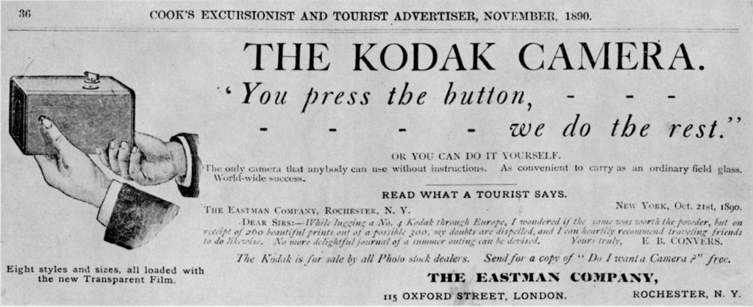
FILM, A BIT OF HISTORY
George Eastman (67)
The Kodak Camera was introduced by George Eastman in 1888. Its simplicity greatly accelerated the growth of amateur photography.
This was due to the fact that the technology was less bulky and now easily accessible to the masses.
His invention of the dry paper jell(film) is considered to be the epitome of both photography and film.

Slide 31
FILM, A BIT OF HISTORY
When a horse is trotting do you think that all its' feet are clear of the ground at the same time?

Slide 32
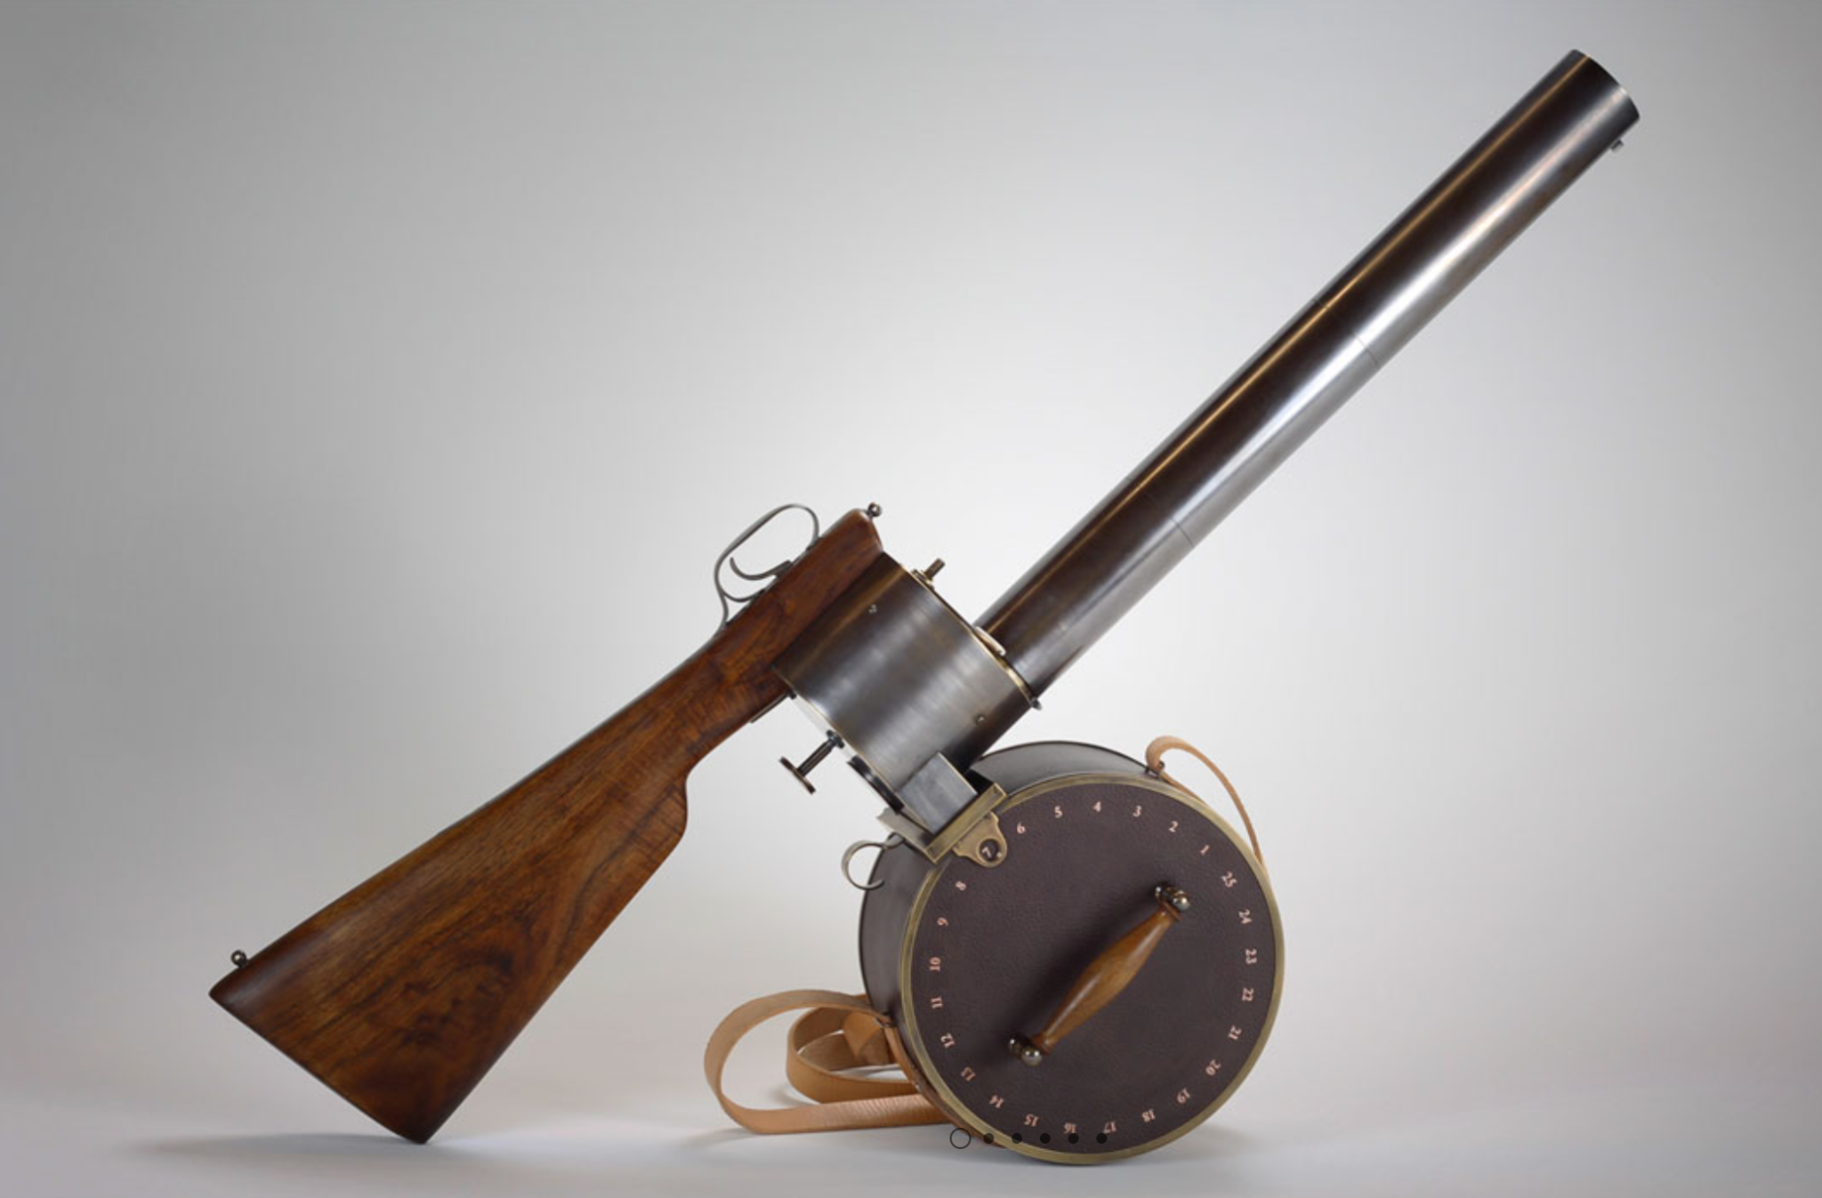
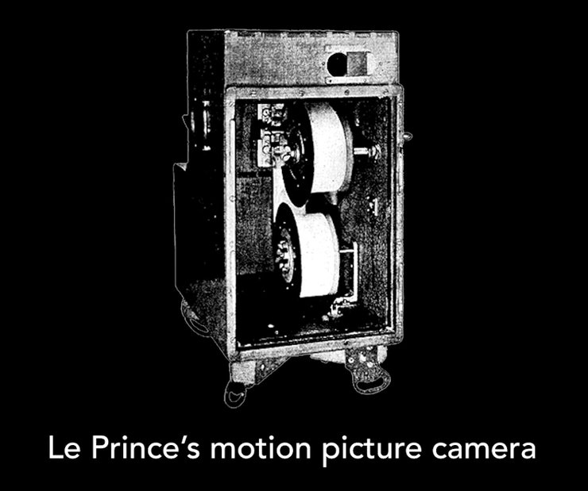
FILM, A BIT OF HISTORY
Etienne-Jules Mary
In 1882 Etienne-Jules Mary invented the chrono-photographic gun. It could shoot shoot 12 frames per second.Fun fact – this is where the term shooting a film originated from.
Louis Le Prince
An awful lot that was going on at this time in terms of figuring out how to work with multiple images and the persistence of vision in the late 1880s. louis Le prince was inspired by Eadweard Muybridge's experiments, tried to make the very first motion picture camera. After a lot of trial and error, he successfully developed the first single lens motion picture camera in 1888.

Slide 33
FILM, A BIT OF HISTORY
Thomas Edison and the Kinetoscope
Kinetoscope - device for viewing moving pictures without sound
VOD - Video on demand.
Edison's impact to film was was indeed great. Through his invention of Kinetoscope he was able to start an early form of VOD service. He created public halls where people would pay to watch content on his kinetoscope. Edison patented this invention on August 31, 1897.This was just the beginning, the industry shift began when people started to gather in halls to watch the projection on walls.
Through his invention film makers at the time we were able to develop;
Combined scenes to form a story. (Robert Paul on the Film come along do).
Continuity editing.
Intercutting of scenes with different shots.(George Albert Smith on the film As seen through a telescope.)
First use of reverse shots.(Robert Paul on the Film Marley's Ghost)
First use of different shot compositions. (Kuleshov and montage theory).
Film copyrights.
First special effects (George Melies).

Slide 34
FILM, A BIT OF HISTORY

Slide 35
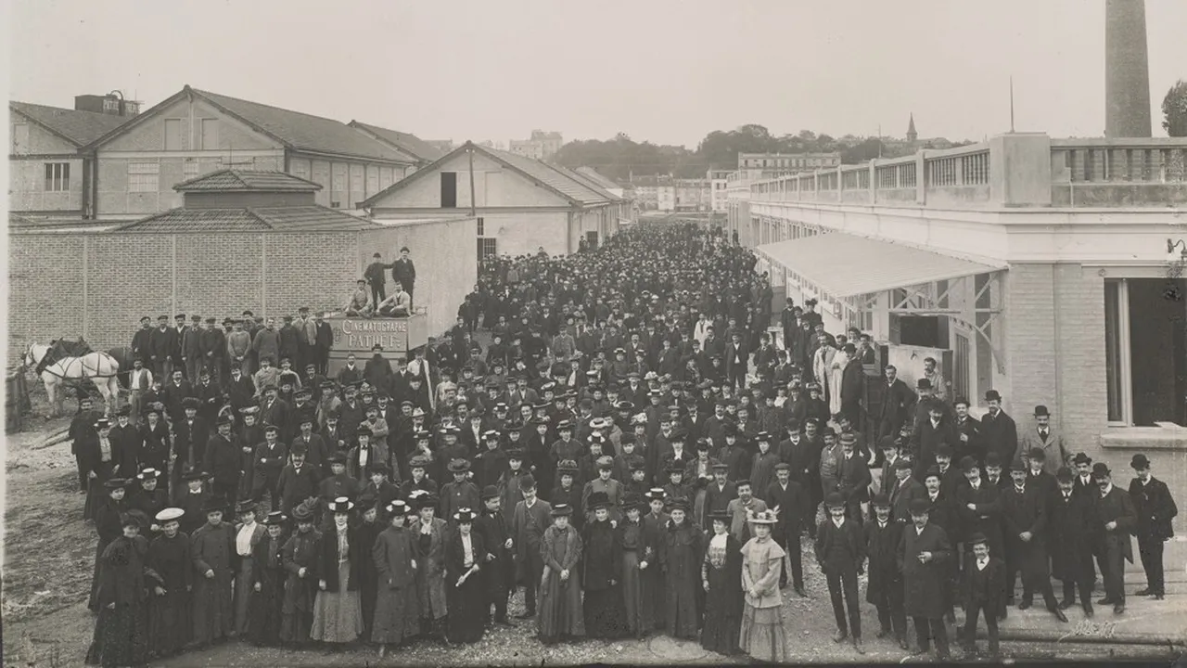
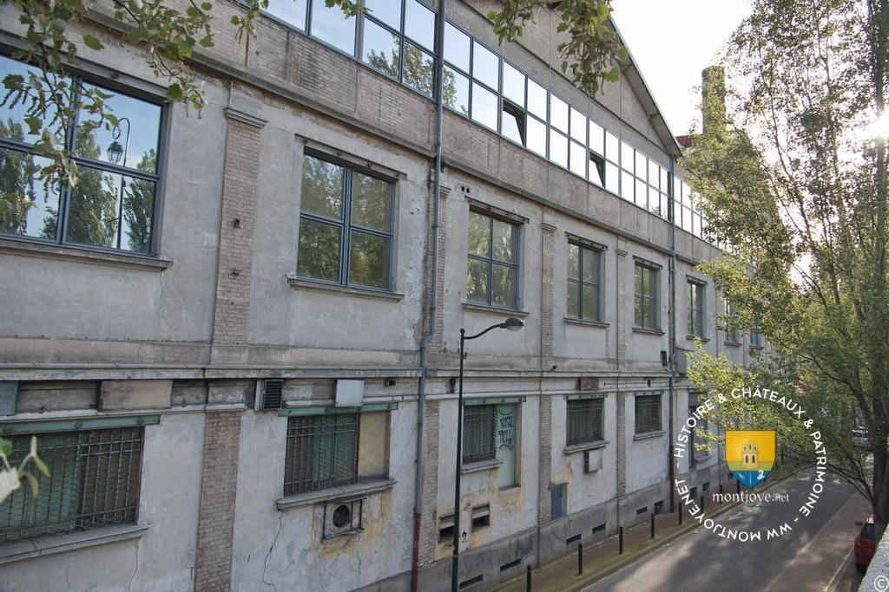
RESTORATION, WHAT ARE THE OPPORTUNITIES?
Each country has its own heritage films and productions. Some might be more than 100 years old as the Meliès movies, other might be more recent.
In both cases, some works need to be done so that these contents can be preserved over the time, licensed and broadcast on today’s media and make sure that these pieces can be seen by the audience worldwide.
Hiventy has a strong reputation in image and sound restoration of heritage films. We do still operate our own film lab in Joinville in a building built by Charles Pathé in 1906 to manufacture film:
Pathé manufacture in 1911
Same building, Hiventy Film Lab today

Slide 36
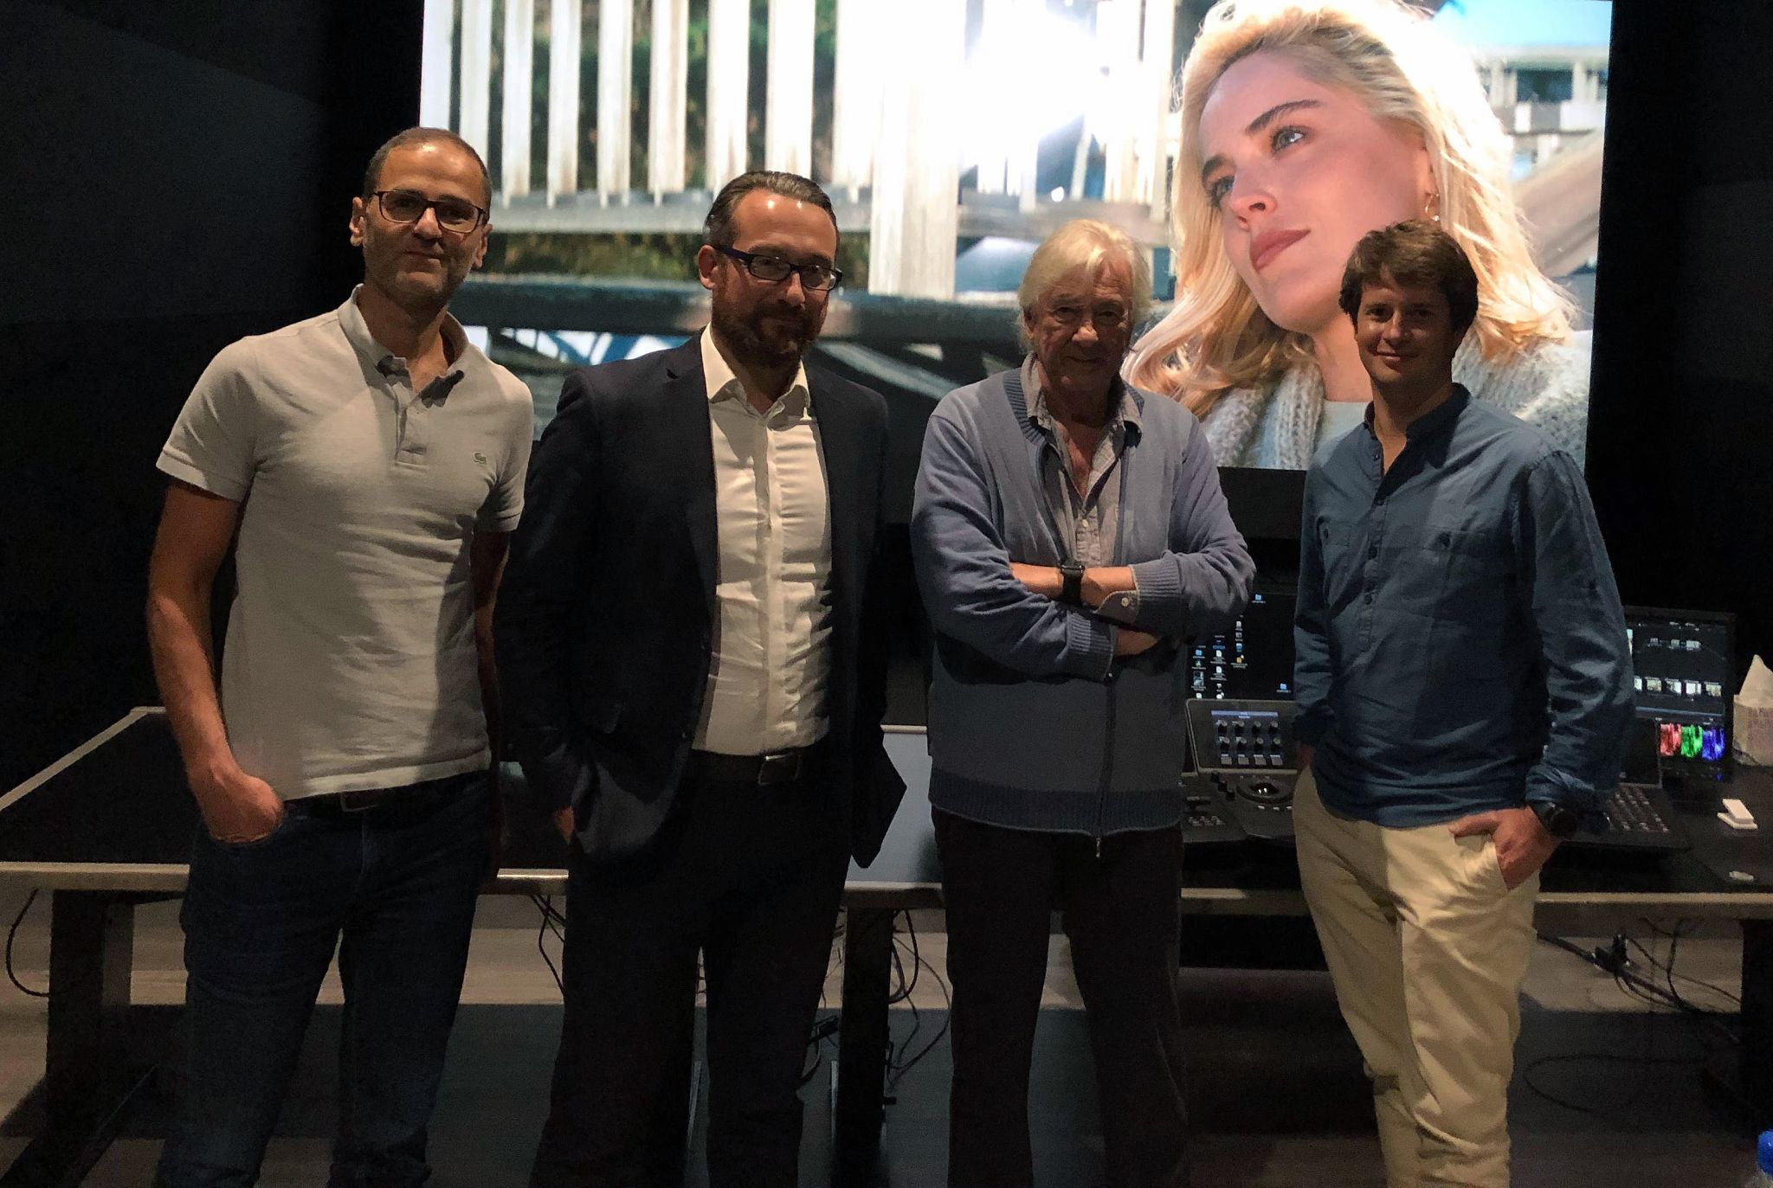
RESTORATION, WHAT ARE THE OPPORTUNITIES?
Restore old contents will enable to:
Make these pieces viewable by today’s audiences on today’s media
Generate revenues and increase the value libraries of titles
Type of contents:
Films from private content owners
Films from Cinematheques (British Film Institute, Cinemathèque Française…)
Films from public archives (ex: ECPAD…)
Corporate films from private companies (Air France…)
Works needed:
From 16mm or 35mm sources:
Always use the available assets providing the highest quality level: 1) original negative, 2) interpositive, 3) internegative...
Steps: Scan 4K, digital restoration, colour grading and final export in 4K or UHD (including HDR when needed), back up on film or LTO for archiving purposes
Paul Verhoeven meeting Hiventy’s team
in Paris

Slide 37
RESTORATION, WHAT ARE THE OPPORTUNITIES?
From final export, creation of all deliverables:
DCP for theatrical release
DVD, Blu-Ray, Blu-Ray UHD
Broadcast copy in SD, HD or UHD
Delivery to any digital platform
Recent projects done at Hiventy: Basic Instinct, Total Recall from Paul Verhoeven.
But also works on older films from Meliès, Jean Renoir, François Truffaut...
From video sources (SD, HD):
We do not upscale the original sources the players in the several devices can do it very well.
Only image and sound restoration.
Example: “H” a French series from 1998 has been delivered in SD from restored masters. Upscale in HD would not be accepted by Netflix. Only native resolution.

Slide 38
TECH SPECS - WHAT’S AT STAKE?
FROM THE SHOOTING TO THE DISTRIBUTION

Slide 39
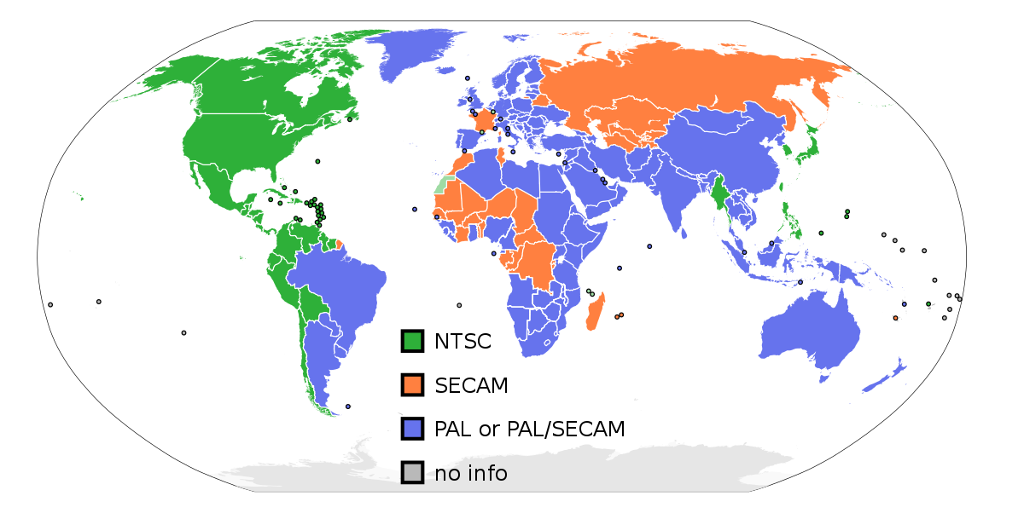
TECHNICAL SPECIFICATIONS TO CONSIDER FROM SHOOTING TO THE DISTRIBUTION OF CONTENT

Slide 40
TECHNICAL SPECIFICATIONS TO CONSIDER FROM SHOOTING TO THE DISTRIBUTION OF CONTENT
WHERE SHOULD YOU REFERENCE SPECIFICATION ?
The Society of Motion Picture and Television Engineers (SMPTE) was founded in 1916. SMPTE is
a global professional association of engineers, technologists, and executives working in the media and entertainment industry. The organisation is an internationally benchmark for broadcast, filmmaking, digital cinema, audio recording, information technology (IT), and medical imaging standards. As of today SMPTE has published more than 800 technical standards relating to the topics mentioned previously.
Why do we use Netflix as our benchmark?
Netflix is the dominant company in the on-demand media industry, with 167 million paying subscribers around the world according to it's share holder's report shared in January 21st 2020.
1 subscriber means 4 viewers.
reference souce https://s22.q4cdn.com/959853165/files/doc_financials/2019/q4/FINAL-Q4-19-Shareholder-Letter.pdf

Slide 41
WHAT ARE THE ACCEPTED CAMERA'S FOR A NETLIX
PRODUCTION
Arri - The preferred recording format is - ARRIRAW ProRes 4444
ARRI Alexa LF - Approved for anamorphic capture
ARRI Alexa Mini LF - Approved for anamorphic capture
ARRI Alexa 65 - Approved for anamorphic capture
Canon -Approved recording formats are Canon RAW, XF-AVC (4K),ProRes HQ (4K)
Canon C300 Mk II, Canon C300 Mk III, Canon C500 Mk II, Canon C500
Canon C700, Canon C700 FF, Canon EOS C70
Panasonic - approved recording formats V-RAW ,AVC-Intra4K, 422 All-I 400Mb/s
Panasonic VariCam 35, Panasonic, VariCam LT, Panasonic, VariCam Pure, Panasonic AU-EVA1, Panasonic S1H, Panasonic BGH1, Panasonic AK-UC4000
Blackmagic - approved recording formats - CinemaDNG RAW (up to 4:1),
Blackmagic RAW (up to 5:1)
Blackmagic Design URSA Mini 4.6K,
Blackmagic Design URSA Mini Pro 4.6K,
Blackmagic Design URSA Mini PRO 4.6K G2
Red - approved recording formats - REDCODE RAW (up to 8:1, 6.1)
Approved for anamorphic capture
RED DSMC2 / WEAPON MONSTRO 8K VV, RED WEAPON DRAGON 8K VV
RED DSMC2 / WEAPON HELIUM 8K S35, RED EPIC-W HELIUM 8K S35
RED WEAPON DRAGON 6K S35, RED EPIC DRAGON 6K S35, RED DSMC2,
EPIC-W GEMINI 5K S35, RED SCARLET-W DRAGON 5K S35,
RED RAVEN 4.5K, RED RANGER MONSTRO 8K VV,
RED RANGER HELIUM 8K S35, RED RANGER GEMINI 5K S35,
RED DSMC2 DRAGON-X 6K S35,
RED KOMODO 6K,
Panavision - approved recording format REDCODE RAW (up to 8:1),
Approved for anamorphic capture
Panavision DXL2
Sony - approved recording formats RAW (up to 4096x2160), X-OCN, XAVC-I
Sony Venice, Sony FX9, Sony F55, Sony F6, Sony FS7 / FS7 II, Sony F5,
Sony FX6, Sony PXW-Z450, Sony PXW-Z750
CHOOSE WHATS IS AFFORDABLE
AND CONVENIENT FOR YOUR
CAMERA CREW

Slide 42
HOW TO ASSES WHETHER YOU HAVE A QUALITY PRODUCED FILM - TECHNICALLY
VIDEO - WHERE WE EXCEL
Should have the following:-
Native Frame Rate. (Recommend is 24 fps progressive why?)
Great white balance for colour accuracy.
Constant exposure depending on the shot.
Great lighting.
Resolution should be consistent throughout the film's shots.
Capture should be free of video defects.
Stable shots when having camera movements

Slide 43
HOW TO ASSES WHETHER YOU HAVE A QUALITY PRODUCED FILM - TECHNICALLY
AUDIO - OUR BIGGEST PITFALL - SOUND IS EMOTION
ADDRESSING THE "WE WILL FIX IN POST ATTITUDE"
Sound is one of the least appreciated but the most important part of the filming process. it's as much a part of telling a story, as a cinematography ,art direction or acting. If you screw it up the audience won't forgive you. They will forgive a blurry shot, a boom mic in the frame or even a weak performance but no one will forgive bad sound. It is simply too annoying. it's very time-consuming and difficult if not impossible to fix most sound mistakes made on location. The hard truth is that it's much more difficult to get good and consistent audio than it is to get good and consistent picture. Audio simply takes more knowledge, time and attention to get right

Slide 44
HOW TO ASSESS WHETHER YOU HAVE A QUALITY PRODUCED FILM - TECHNICALLY
AUDIO - OUR BIGGEST PITFALL
FIVE GOLDEN RULES FOR SOUND RECORDING.
Get the microphone as close as possible. ( Beware of Video Framing.)
Always use professional headphones to monitor audio levels. (Personal Favourite Sony MDR 7506).
Monitor the sound from camera.
Scout your location for sound.(Murphy's law states that anything that can go wrong will go wrong.)
Always record room.( Record using the mic that recorded dialogue).

Slide 45
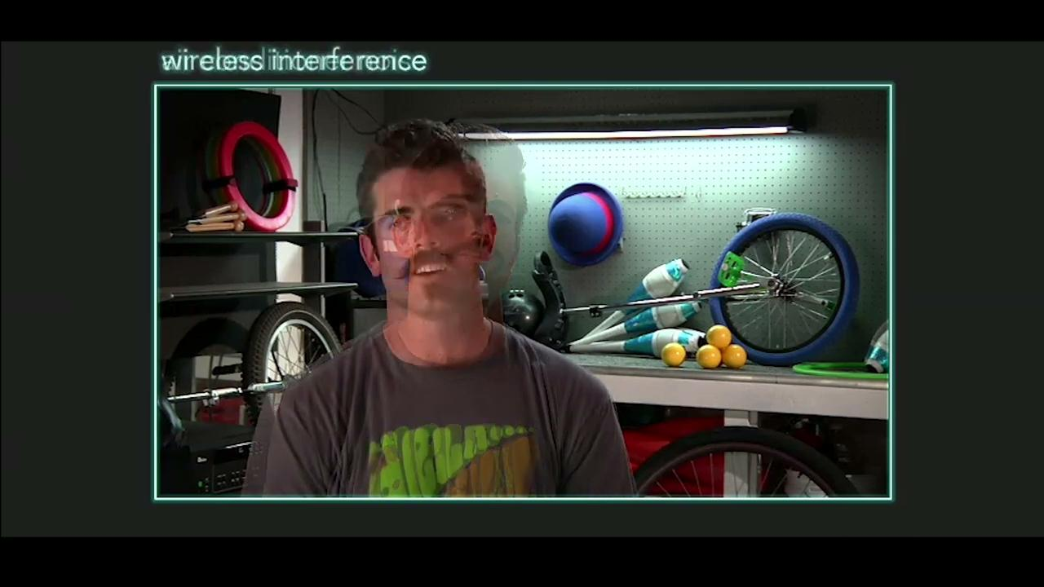
HOW TO ASSES WHETHER YOU HAVE A QUALITY PRODUCED FILM - TECHNICALLY
AUDIO - EAR TRAINING FOR THE AUDIENCE

Slide 46
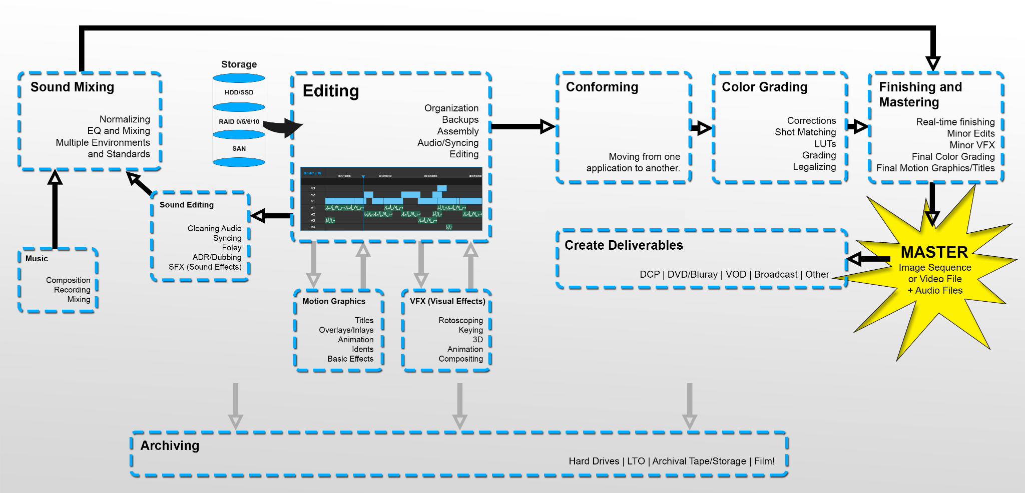
POST PRODUCTION
AUDIO VISUAL SESSION MANAGEMENT

Slide 47
POST PRODUCTION
AUDIO VISUAL SESSION MANAGEMENT
TECHNICAL SPECIFICATIONS PACKAGING FOR NETFLIX CONTENT : VIDEO
For the visual assets there are two types of deliveries which are:
The IMF
Audio-Visual Asset.
IMF is a file-based framework held up by the Society of Motion Picture and Television Engineers (SMPTE) as standard 2067-2. It’s designed to simplify the file exchange process by creating a single master file for distribution. That means distribution of content between businesses, however, not for delivery directly to the consumer.
IMF is actually an evolution of the Digital Cinema Package (DCP), which has been the standard for distributing theatrical content since 2012. Over the last few years, IMF has been adapted to suit the particular challenges of broadcast and online distribution. Specifically, it’s made it easier to manage and process multiple versions of a film or promo to fit, say, airline edits, special editions, alternate languages, or territorial compliance.
IMF gives teams a solid workflow that helps them stay consistent—even across different countries—as they tackle QC, mastering, and versioning for productions.

Slide 48
POST PRODUCTION
AUDIO VISUAL SESSION MANAGEMENT
TECHNICAL SPECIFICATIONS PACKAGING FOR NETFLIX CONTENT : VIDEO
4K DCI Image Track
Image Frame Width | 4096
Image Frame Height | 2160
Frame Rates | 23.976 / 24 / 25 / 29.97 / 30 / 50 / 59.94 / 60
Frame Structure | Progressive
Stereoscopy | Monoscopic
JPEG 2000 Profile | Frame rates up to 30 fps use:
 | ● 4k IMF Single Title Lossy Profile Mainlevel 6 Sublevel 3 (max 800 Mbit/s)
 | Frame rates above 30 fps use:
 | ● 4k IMF Single Title Lossy Profile Mainlevel 7 Sublevel 4 (max 1600 Mbit/s)
Dynamic Range | Dolby Vision HDR | SDR
Colorimetry | P3D65 / SMPTE ST 2084 (PQ) | ITU-R BT.709 / D65 / ITU-R BT.1886
 |  | (Gamma 2.4)
Color Encoding | RGB / 4:4:4 / Full Range | RGB / 4:4:4 / Full Range
Pixel Bit Depth | 12 bit | 10 bit
Mastering Display Color Volume Metadata | SMPTE ST-2086 | n/a
Dynamic Metadata for Color Volume Transformation | Dolby Vision CM 2.9 or CM 4.0 mastering metadata. | n/a

Slide 49
POST PRODUCTION
AUDIO VISUAL SESSION MANAGEMENT
Audio Tracks Delivery
Codec / Container | Uncompressed Linear PCM (.wav)
Bitrate | Highest Possible (CBR)
Sample Rate | 48kHz
Bit Depth | 16bit / 24bit
Channel Count | 2, 6 or 8
Channel Mapping
2.0 Only:
● Channel 1 – Stereo Left
● Channel 2 – Stereo Right
5.1 Only:
● Channel 1 – Left
● Channel 2 – Right
● Channel 3 – Center
● Channel 4 – LFE
● Channel 5 – Left Surround
● Channel 6 – Right Surround
5.1 + 2.0:
● Channel 1 – Left
● Channel 2 – Right
● Channel 3 – Center
● Channel 4 – LFE
● Channel 5 – Left Surround
● Channel 6 – Right Surround
● Channel 7 - Stereo Left
● Channel 8 - Stereo Right

Slide 50
POST PRODUCTION
AUDIO VISUAL SESSION MANAGEMENT
HOW TO NAME YOUR ASSETS (NAMING CONVENTION)
Item | Naming | Example
Project Title | project_title | chefs_table
Season # / Episode # / Longplay | s[season ##]e[episode ##] or r[reel ##] or lp[longplay] | s01e01, s01e02, s01e03 or r01, r02, r03 or lp
Picture Sync Time Code Rate | time code rate without period | 23.976, 24, 25, 29.97, 30
Asset Type | asset type | PM, ME
Soundfield Type | soundfield type | Nearfield, Immersive
No. of Channels | mono, 2ch or 6ch | mono, 2ch, 6ch
Sample Rate | [##]k | 48k
Bit Depth | [##]b | 24b
Channel/Track Mapping | channel/track designation | L, R, C, LFE, LS, RS, LT, or RT
Version # (for Mixes or Stems) | v[##] | v04
Production materials should have “human readable” filenames, avoid using proprietary catalog IDs and should contain all of the following information:
Project Title
Season # / Episode # / Longplay
Picture Sync Time Code Rate
Asset Type
Soundfield Type
No. of Channels
Sample Rate
Bit Depth
Channel/Track Mapping
Version # (for Mixes or Stems)

Slide 51
NAMING CONVENTION SAMPLES
Stereo Printmaster Example: chefs_table_s01e01_23976_PM_Nearfield_2ch_48k_24b_LT_v04.wav chefs_table_s01e01_23976_PM_Nearfield_2ch_48k_24b_RT_v04.wav
chefs_table_s01e01_23976_PM_Nearfield_2ch_48k_24b_L_v04.wav chefs_table_s01e01_23976_PM_Nearfield_2ch_48k_24b_R_v04.wav
Discrete 5.1 Printmaster Example: chefs_table_s01e01_23976_PM_Nearfield_6ch_48k_24b_L_v04.wav chefs_table_s01e01_23976_PM_Nearfield_6ch_48k_24b_R_v04.wav chefs_table_s01e01_23976_PM_Nearfield_6ch_48k_24b_C_v04.wav chefs_table_s01e01_23976_PM_Nearfield_6ch_48k_24b_LFE_v04.wav chefs_table_s01e01_23976_PM_Nearfield_6ch_48k_24b_LS_v04.wav chefs_table_s01e01_23976_PM_Nearfield_6ch_48k_24b_RS_v04.wav
Discrete 5.1 Music & Effects Example: peewee_lp_23976_ME_Nearfield_6ch_48k_24b_L_v02.wav peewee_lp_23976_ME_Nearfield_6ch_48k_24b_R_v02.wav peewee_lp_23976_ME_Nearfield_6ch_48k_24b_C_v02.wav peewee_lp_23976_ME_Nearfield_6ch_48k_24b_LFE_v02.wav peewee_lp_23976_ME_Nearfield_6ch_48k_24b_LS_v02.wav peewee_lp_23976_ME_Nearfield_6ch_48k_24b_RS_v02.wav

Slide 52
NETFLIX ASSETS REQUIRED FOR LOCALIZATION
Netflix may request miscellaneous production material to assist in the localization of licensed content.The following “Asset Types” may be requested:
Printmaster Audio *
Printmaster Audio: Localized*
Music & Effects (M&E) *
Dialogue Music & Effects Stems (DME)*
Optional Tracks*
Language Template*
Dialogue List*
Pivot Language Dialogue List (PLDL)*
As Recorded Dubbing Script*
Audio Description Script*
Dialogue Audio Stem: Localized*
Audio Description Audio Stem: Localized*
Audio Description Mix Project Files*
Localized Mix Project Files*
KNPs
Show Guides
Locked Proxy *

Slide 53
BLOCKERS TO NETFLIX SUBMISSIONS
AUDIO VISUAL SESSION MANAGEMENT
Source Material Requirements - There are no exceptions to the following requirements
Deliveries must not contain bars and tones, bumpers, segment recaps or previews, advertisements, slates, ratings cards, FBI warning cards, VITC time code, placards, overlay branding or website link callouts before, during and/or after the program. URLs present during end credits are permissible.
All files must consist of the feature program with one (1) second of black and silence at the head and tail of the program (one [1] frame to one [1] second of black and silence is acceptable if providing ProRes files)
If Source Material has commercial blacks, each commercial black segment must be trimmed down to two (2) seconds or less in the final mezzanine delivery
Netflix requires a non-subtitled version of the content. Netflix defines “non-subtitled” as the presence of main titles, end credits, location call-outs, and other supportive/creative text, but no burned-in subtitled dialogue, regardless of the language in the primary video
Netflix requires separate Forced Narrative Subtitle files to accommodate all plot pertinent on-screen text

Slide 54
BLOCKERS TO NETFLIX SUBMISSIONS
AUDIO VISUAL SESSION MANAGEMENT
Netflix requires seamless versions of episodic content. Commercial bumpers and segment previews and recaps must be removed. Episode previews and recaps are permitted
Video Sources: Netflix accepts IMF Application 2 Extended or iTunes® packaged ProRes files
All ProRes 422 HQ files must meet the iTunes package specifications
Titles must be delivered as long-play and cannot be split into multiple deliveries , e.g., if a title is 90 minutes in duration, a single file with a 90-minute duration must be delivered. Two (2) files with 45-minute durations will not be accepted.
Netflix requires files to be delivered in their native frame rates. Netflix defines this to mean what the material was originally shot in or edited with regards to frame rate. If it was originally a film, Netflix requires the native film frame rate (either 23.976p, 24p, or 25p). This is often different from the frame rate that is used for tape, archival storage, and delivery to broadcasters (typically 29.97i df, or 25i). No 3:2 Pulldown flags allowed.
Netflix requires files to be delivered in their original aspect ratio. Netflix will not accept a 4x3 version when a 16x9 version was originally created.
Up-resing of content is prohibited. SD sources cannot be used to create HD deliverables. 4K video must come from a true 4K source and maintain unity in 4K throughout the entire post-production pipeline.

Slide 55
POST PRODUCTION
AUDIO VISUAL SESSION MANAGEMENT
BLOCKERS TO NETFLIX SUBMISSIONS
Source material must be of a quality that is equal to or greater than that of the chosen Netflix specification. Example: 15mbit Long GOP HD Mpeg2 cannot be used to create ProRes 422 HQ
Source material must be uncensored. Translations within secondary audio and timed text assets should not introduce slurs that were not present in the original language or unnecessarily harshen/soften the language used, unless specifically requested by Netflix.
Content with runtimes of less than 11 minutes must be combined to create longer episodes. All credits should be moved to the end of program and should run in the same sequence that the episodes appear stitched together.
Partner shall deliver Source Material via the Netflix Backlot. Netflix Backlot is accessible via GUI (graphical user interface) and/or through API (application programming interface) integration with the vendor’s Asset Management System.

Slide 56
ASSET MANAGEMENT

Slide 57
ASSET MANAGEMENT - GAINS & OPPORTUNITIES?
NEW TOOLS AND WORKFLOWS REQUIRED TO COMPLY WITH THE EVOLUTION OF THE MARKET
Major changes in the offer to the final consumer driven by the arrival of global, regional and local digital platforms
=> more distribution opportunities to more broadcasters (non exclusive rights)
=> contents can be made available to a broader audience worldwide
More broadcast modes and territories => more windows => more deliveries => more technical costs
Business model has changed: more sources of revenues but smaller revenues
Increase of technical costs to provide broadcast materials
=> Optimization required to reduce the costs attached to each delivery
FROM A CONTENT OWNER PERSPECTIVE
Permanent accessibility to source materials
Multiple deliveries needed anywhere in the world
Technical costs to be in line with revenues driven by sales
FROM A VENDOR PERSPECTIVE
Ability to handle large volumes (5 000+ assets / deal)
Ability to handle any kind of specs and workflows
Compliance with technical requirements is a must have
Reactiveness to meet tight deadlines

Slide 58
ASSET MANAGEMENT - GAINS & OPPORTUNITIES?
MARKET DRIVEN SINGLE OFFER
ON INGEST, QC, STORAGE, ASSET MANAGEMENT AND DELIVERY BY HIVENTY:
Target: help you sale and deliver your programs :
=> Give more value to your library of contents and make new sales possible = increase revenues
=> Reduce technical costs attached to each sales = lower down costs
=> Increase profitability
How:
Clear and complete inventory, audit of all assets available on your library of titles
Streaming links for viewing purposes to ease sales
Automated delivery workflows
An offer relying on :
Properly ingested and qualified / Qced assets: the more we now about the assets the more we can automate downstream
Secured online storage guaranteeing permanent and immediate accessibility to assets
Client oriented asset management web platform
Automated workflows for straight deliveries
Automated or semi automated workflows on file conversion and delivery to any broadcaster’s specs

Slide 59

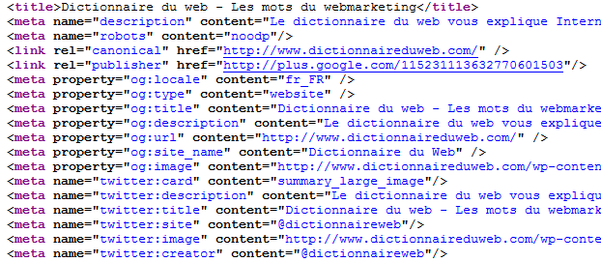

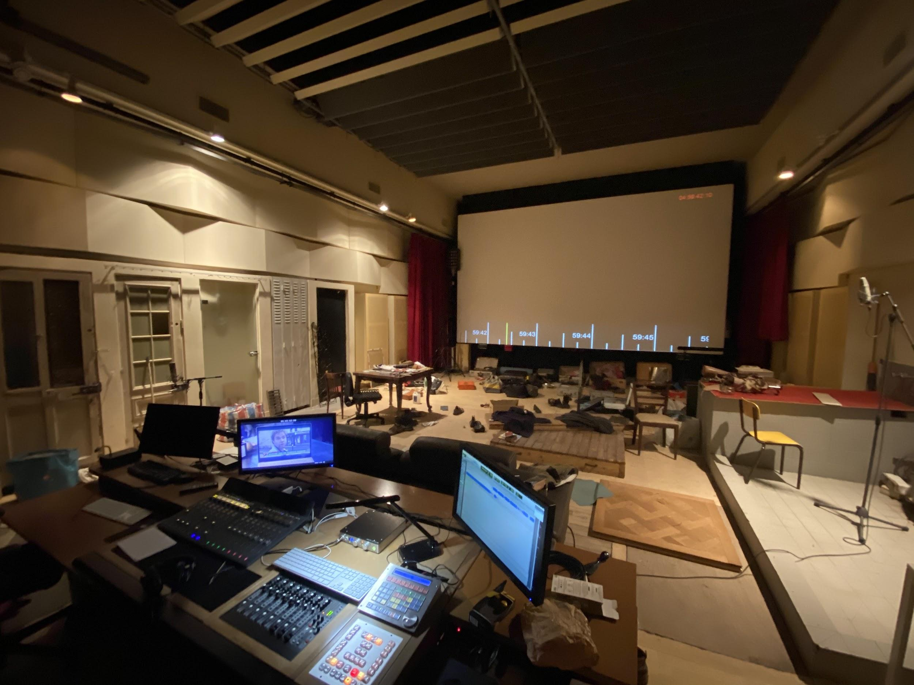



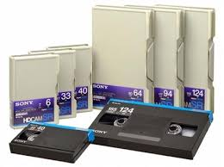




ASSET MANAGEMENT - GAINS & OPPORTUNITIES?
META
DATAS
INGEST
STORAGE
METADATAS
ONLINE
ASSET MANAGEMENT PLATFORM BEHIVE
STORAGE
ASSETS
NEW SHOWS
QUALIFICATION / QC
INGEST
LIBRARY
DIGITIZATION AND RESTORATION
INGEST

Slide 60
ASSET MANAGEMENT - GAINS & OPPORTUNITIES?
Steps to ingest existing assets:
Inventory of existing assets
Audit on quality (based on samples)
Migration plan and creation of the list of expected master files to be ingested
Ingest and qualification / Qc of all assets
Restoration (if needed)
Ingest and qualification of metadatas
Once assets have been properly ingested and qualified, access is granted to all our workflows with the ability to deliver any TV network or digital platform in the world.
Asset management web platform: BeHive:
Inventory of stored assets with technical and editorial metadata
Automated orders
Manual orders
Monthly reports

Slide 61
ASSET MANAGEMENT - GAINS & OPPORTUNITIES?
BUSINESS MODEL:
Per asset flat fee for ingest and qualification
Monthly subscription for storage and access to our asset management platform
Per delivery or monthly subscription for deliveries based on your needs
Gains are made from the first delivery: the discount on the technical deliveries covers the costs for ingest and qualification.
Once assets have been properly ingested and qualified, additional deliveries can be made at very low cost thanks to automated workflows.
CASE STUDY: FRENCH ANIMATION VENDOR
Migration of existing assets: we have migrated and ingested more than 5 000 video assets over 18 shows, for about 45TB of data in a 6 months period of time.
All new shows are now properly ingested and QCed to guarantee full licensing to any broadcaster.
Our client’s sales team is now uses BeHive every day to order deliveries using Aspera or FTP protocols on its own. Even during the sanitary lockdown they could maintain their deliveries with BeHive.

Slide 62
ASSET MANAGEMENT - GAINS & OPPORTUNITIES?
PRESENTATION OF OUR ONLINE ASSET MANAGEMENT TOOL: BEHIVE
https://behive.hiventy.com/

Slide 63
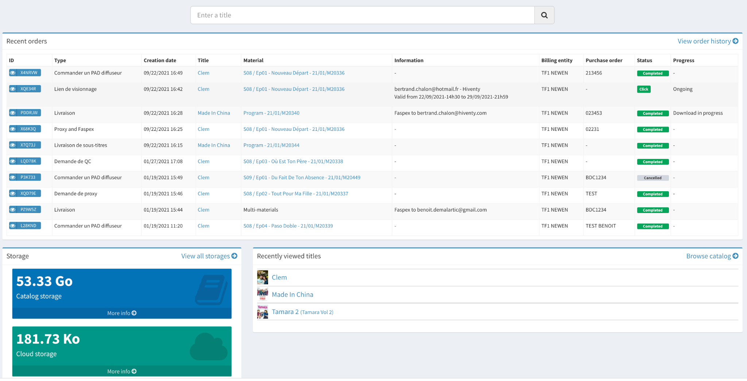
ASSET MANAGEMENT - GAINS & OPPORTUNITIES?

Slide 64
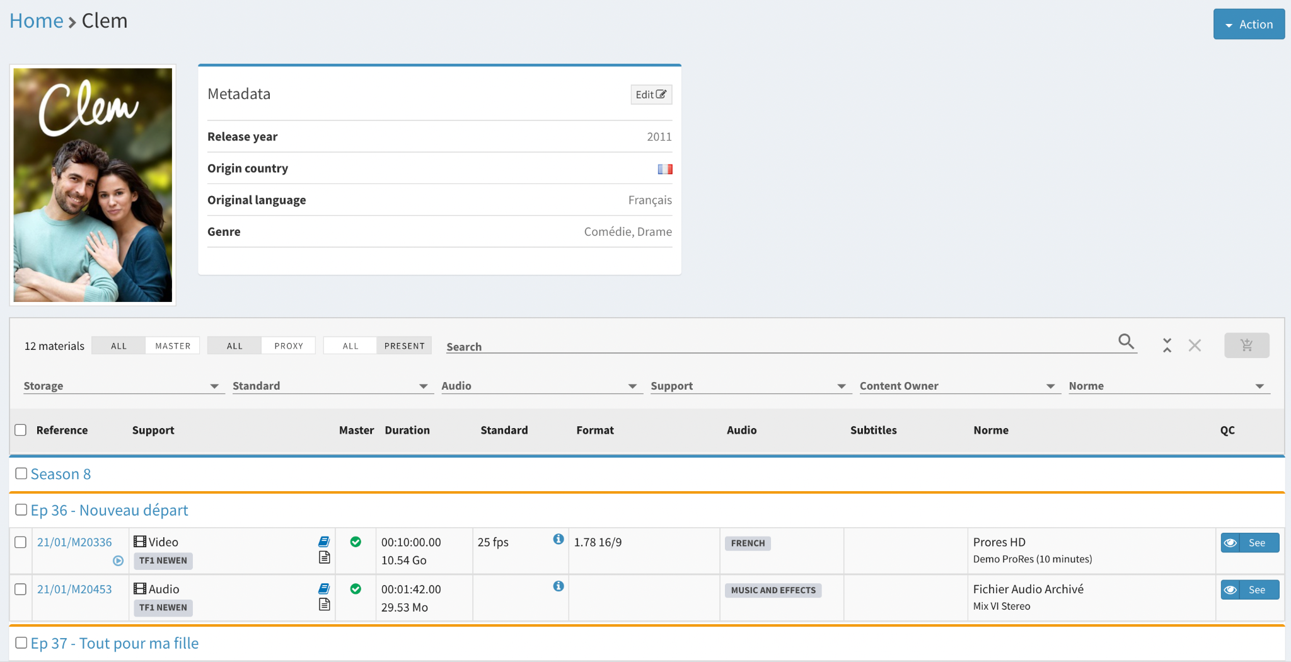
ASSET MANAGEMENT - GAINS & OPPORTUNITIES?

Slide 65
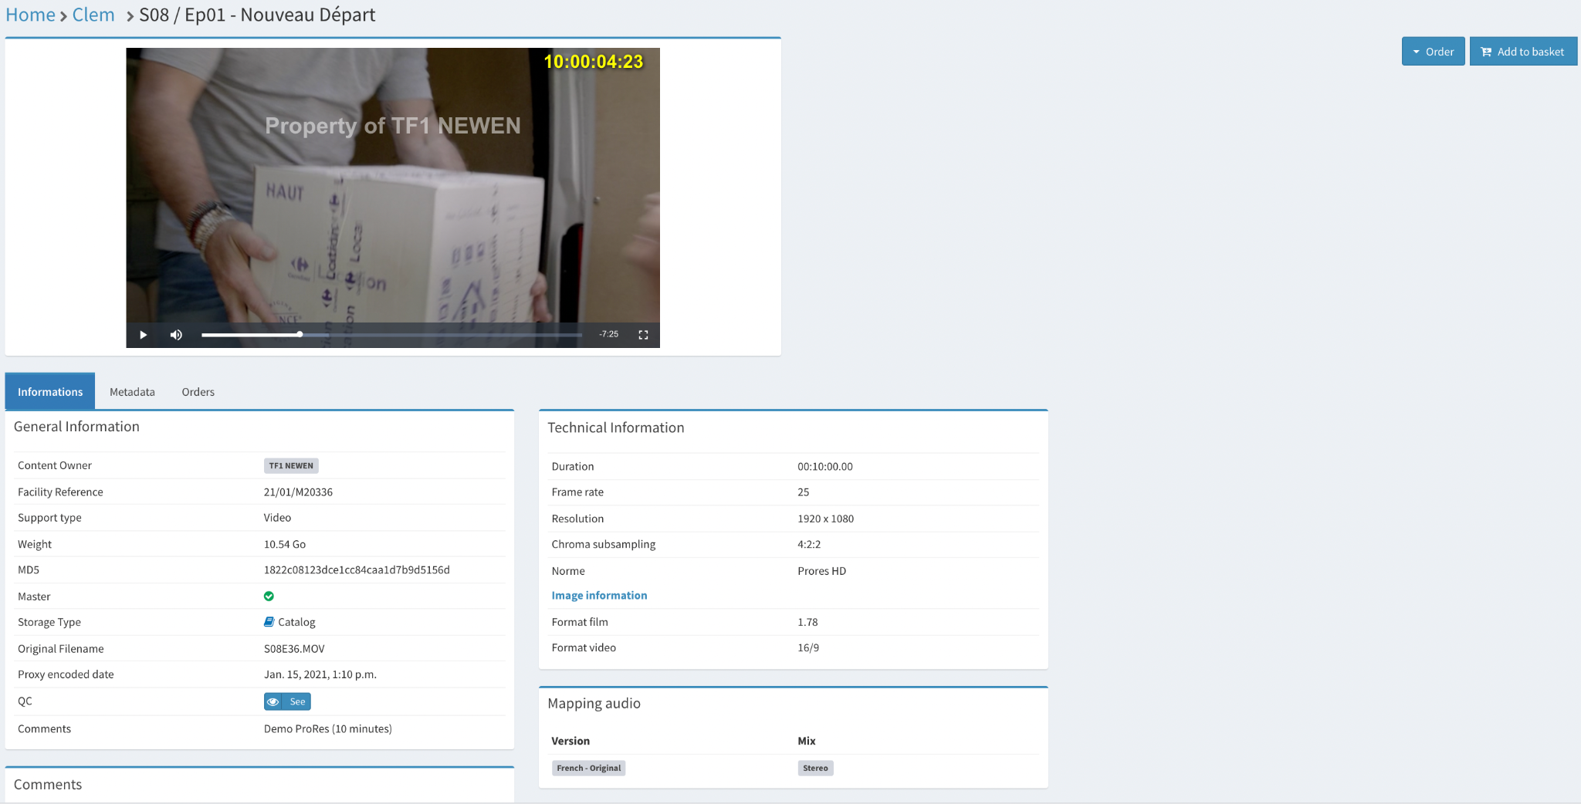
ASSET MANAGEMENT - GAINS & OPPORTUNITIES?

Slide 66
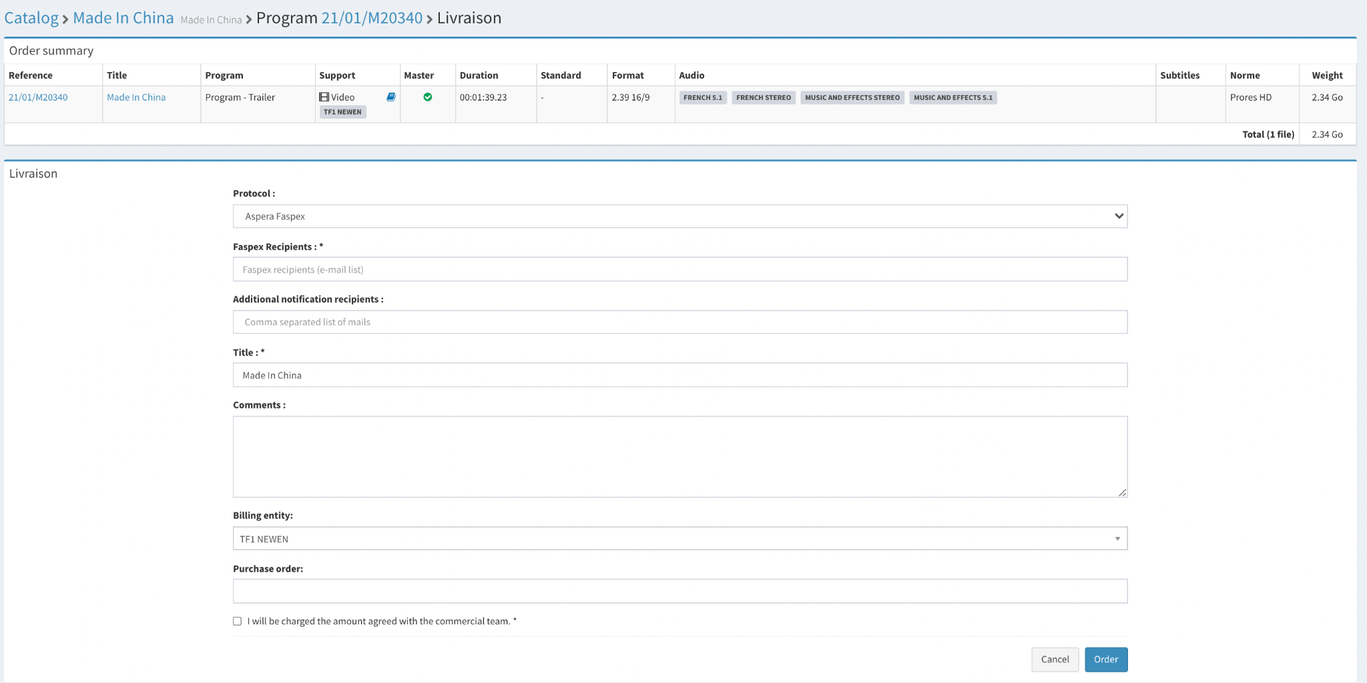
ASSET MANAGEMENT - GAINS & OPPORTUNITIES?

Slide 67
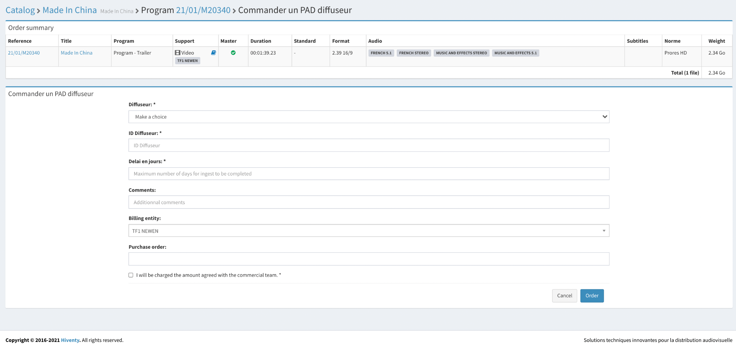
ASSET MANAGEMENT - GAINS & OPPORTUNITIES?

Slide 68
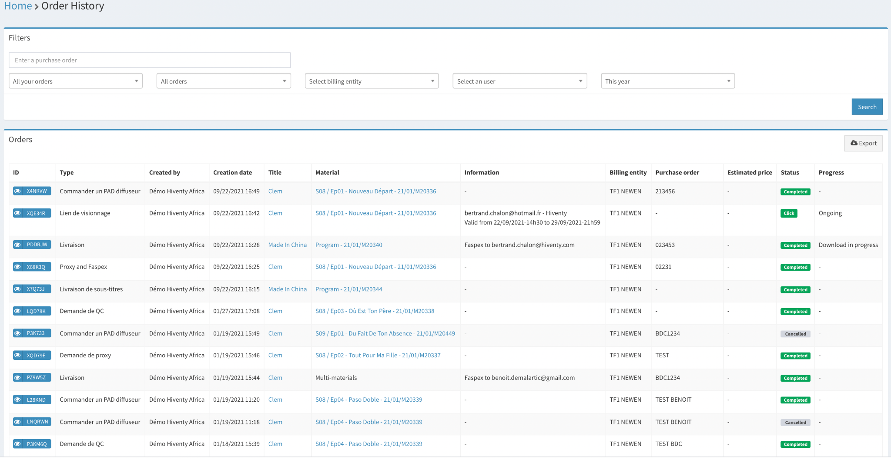
ASSET MANAGEMENT - GAINS & OPPORTUNITIES?

Slide 69


MANY THANKS
POLAND Ι VIETNAM Ι SINGAPORE Ι KENYA Ι NIGERIA

